Slide 1
Explainable AI

Slide 2
What is Explainable AI
“Explainable AI is a set of tools and frameworks to help you understand and interpret predictions made by your machine learning models. With it, you can debug and improve model performance, and help others understand your models' behaviour”

Slide 3
Need of Explainable AI
Let’s say you are a reputed doctor to whom a Data Scientist comes and says -
“Hi, I’ve built a model to predict if a person has skin cancer or not. You should set it up in your hospital.” Will you completely trust the person?
Many questions might arise in your mind -
On what basis does this model classify an image as cancerous?
How reliable is it?
Will it be more helpful than the cancer experts we have here?
Even the Data Scientist might not be able to answer your questions well. So what should be done to know how trustworthy a model is? Can we help the Data Scientist out?

Slide 4
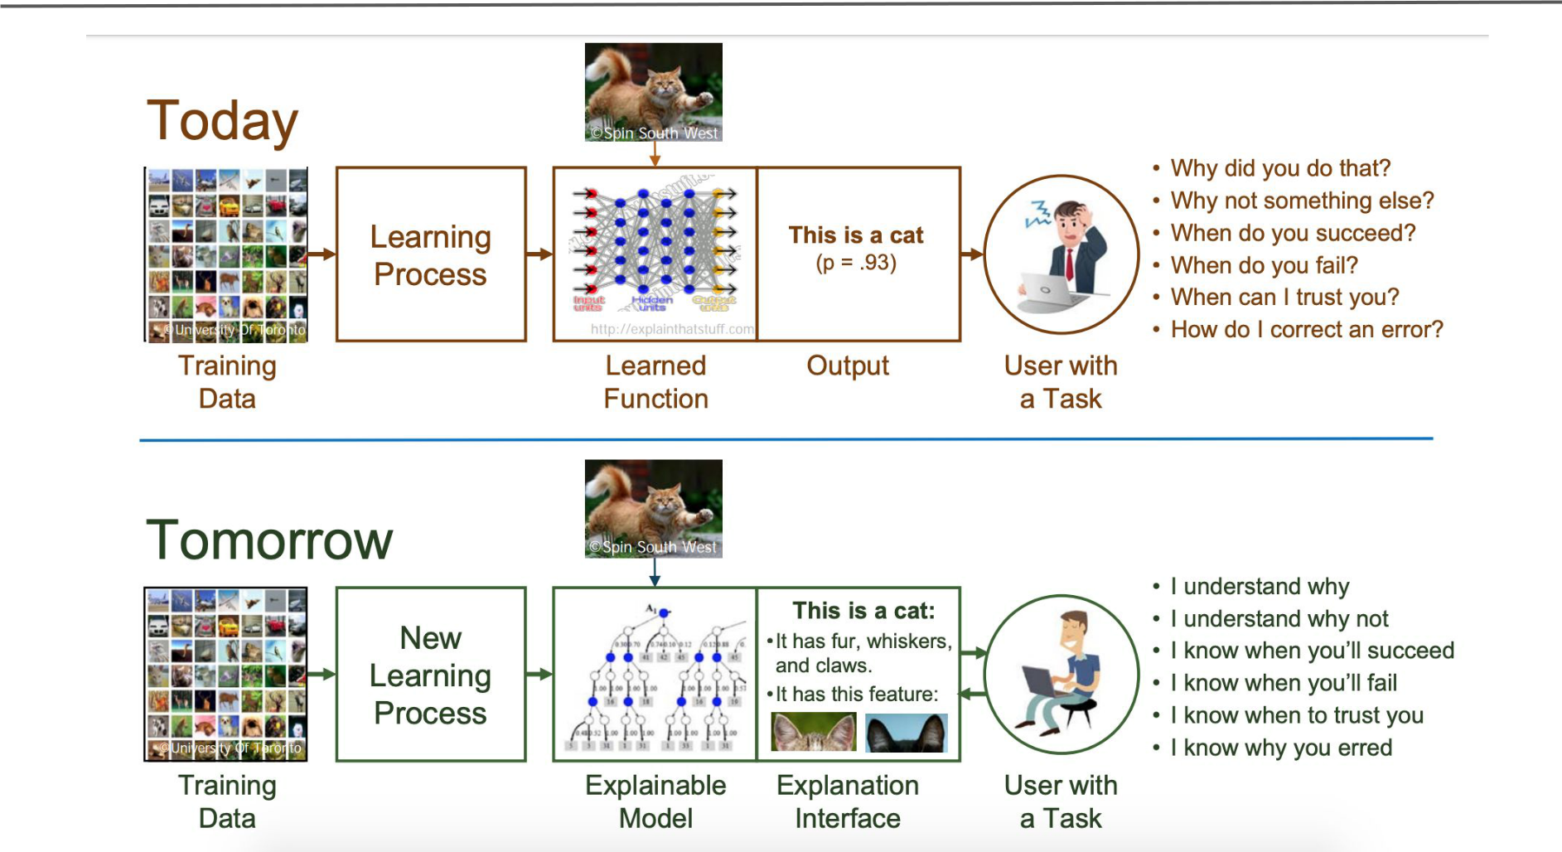

Slide 5
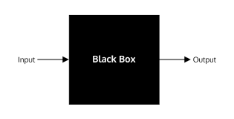
The Black Box
Since the start of the path to the mainstream adoption of AI, it has been common practice to train machine learning models with a black-box approach — as long as they give us good results, it doesn’t matter if we can’t explain them
Now, the focus is slowly turning towards the transparency and explicability of these models. We want to know WHY they come up with the predictions they output..

Slide 6
Advantages
In some other critical areas, like medicine, where AI can have such a great impact and make amazing improvements to our quality of life, it is fundamental that the used models can be trusted without a hint of a doubt. Having a Netflix recommendation system that sometimes outputs strange predictions might not have a very big impact, but in the case of medical diagnosis, strange/wrong predictions could be fatal. Providing more information than just the prediction itself, allows the users to decide whether they trust the prediction or not

Slide 7
Model Interpretation
Model interpretation tries to understand and explain the decisions taken by the model, i.e., the what, why and how. The three most important aspects of model interpretation are:
Transparency
The ability to question
The ease of understanding

Slide 8
What does it mean to interpret a model?
Let’s start by defining exactly what it means to interpret a model. At a very high level, we want to understand what motivated a certain prediction.
For instance, let's use the problem from the XGBoost documentation, where, given the age, gender and occupation of an individual, I want to predict whether or not they will like computer games

Slide 9
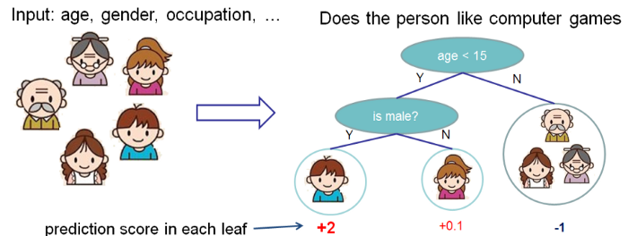
What does it mean to interpret a model?
In this case, my input features are age, gender and occupation. I want to know how these features impacted the model’s prediction that someone would like computer games.

